Slide 1



Routing III
รศ.ดร. อนันต์ ผลเพ่ม
Asso. Prof. Anan Phonphoem, Ph.D.
anan.p@ku.ac.th http://www.cpe.ku.ac.th/~anan Computer Engineering Department Kasetsart University, Bangkok, Thailand

Slide 2
Outline
Intermediate-System to Intermediate- System (IS-IS)
Border Gateway Protocol (BGP)
IPv6 Routing

Slide 3
Routing Protocol
IGP (Interior Gateway Protocol)
Exchange routing info. within an AS
RIP, IGRP, EIGRP, OSPF
EGP (Exterior Gateway Protocol)
Exchange routing info. between AS
BGP
Autonomous System (AS) [RFC 1771]
“A set of routers under the single technical administration, using an IGP and common metrics to route packets within the AS, and using an EGP to route packets to other AS’s.”
Notes:
Igp แตกเป็น LINK กับ RIP
EGP แตกเป็นpath

Slide 4
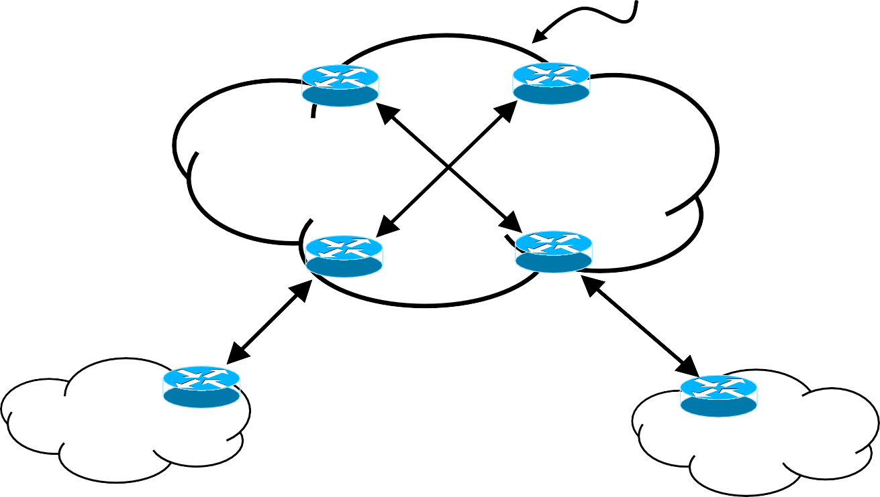
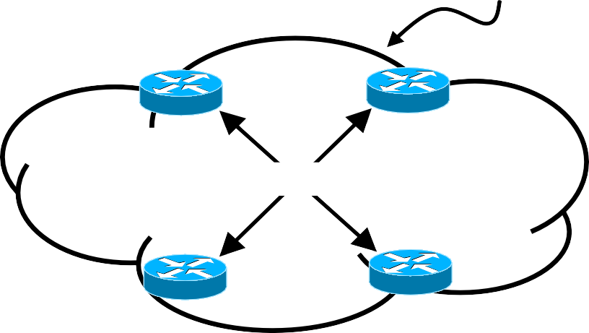
Internet - Early Age
Internet Backbone
EGP Restriction:
•Tree only
•One Backbone
EGP
EGP
EGP
EGP
EGP
EGP
EGP
EGP
EGP
IGP
AS 1
AS 2
IGP

Slide 5
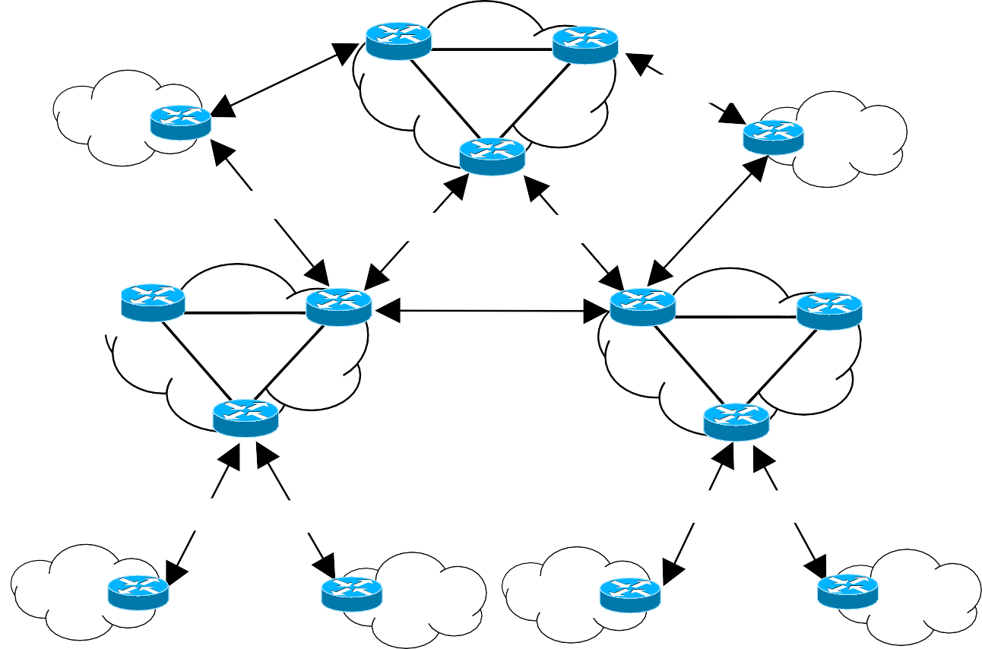
Internet – Current State
ISP1
ISP Connection
•Tree -> Graph
BGP-4
IGP
BGP-4
BGP-4
BGP-4
BGP-4
ISP2
BGP-4
ISP3
IGP
IGP
BGP-4
BGP-4
BGP-4
BGP-4
Notes:
แต่ละหน่วยงานจะคุยกันต่างๆ กัน แต่แตละ จะคุยด้วยBGP เป็นตัวแทนของexterior

Slide 6


Autonomous System (AS)
Autonomous System
AS 5
AS 1
Boarder router (ASBR)
Exterior Gateway Protocol (EGP Link)
AS 20
AS 7
Interior Gateway Protocol
(IGP Link)
This is the Internet !

Slide 7
Border Gateway Protocol
BGP
BGP-4
Concentrate on Loop-Free > lowest cost
Based on policy
e.g. lowest # of AS
Need to go through AS 12
Advanced distance vector routing protocol
Path Vector routing protocol
Notes:
อยู๋ที่ขอบเป็นตัวที่link ระหว่าง AS เน้นLoop free
แล้วbased on policy
มี Path vector routing

Slide 8
Path Vector Routing
Limitation of Distance vector / Link state
Interior routing protocol (Intra-Domain/AS)
Exterior routing protocol (Inter-Domain/AS)
Router holds
a list of networks that can be reached with the path (ASs to pass)
x.x.x.x can be reached through AS y
■ RFC 1772
Notes:
ไม่สามารถสเกลได้
จะเป็นList ของเครือข่ายต่างๆที่สามารถไปถึงได้

Slide 9
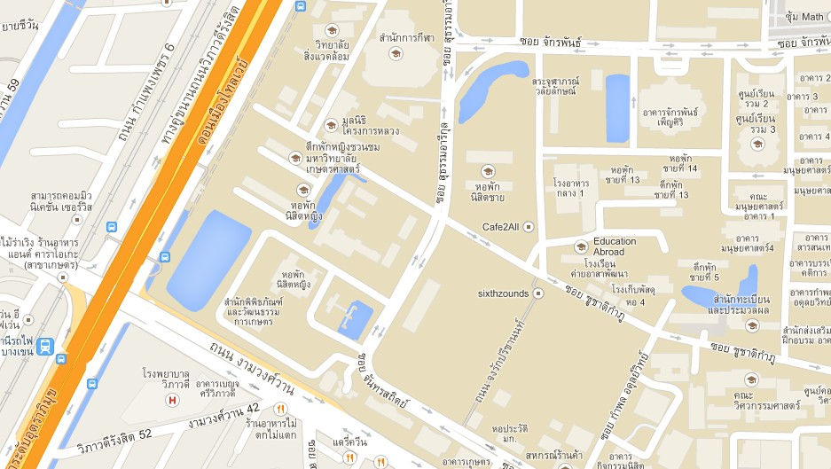
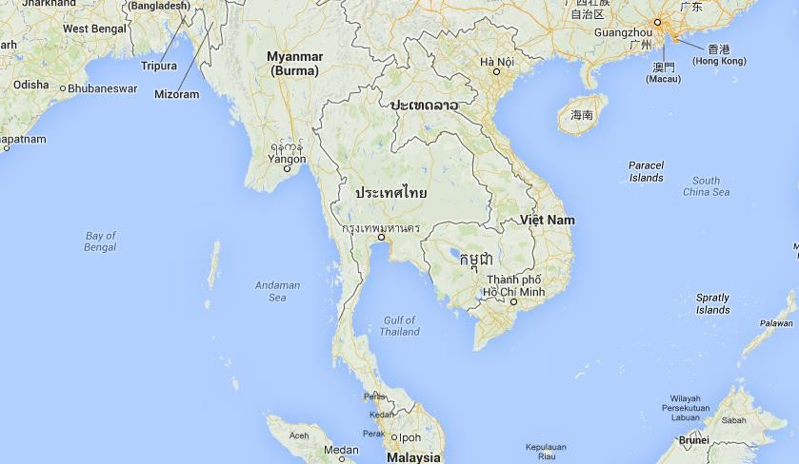
Path Vector Routing Analogy
National map (Distance Vector)
road, city, distance
International Map (Path Vector) existing of cities in each country should be passed to reach destination
9

Slide 10
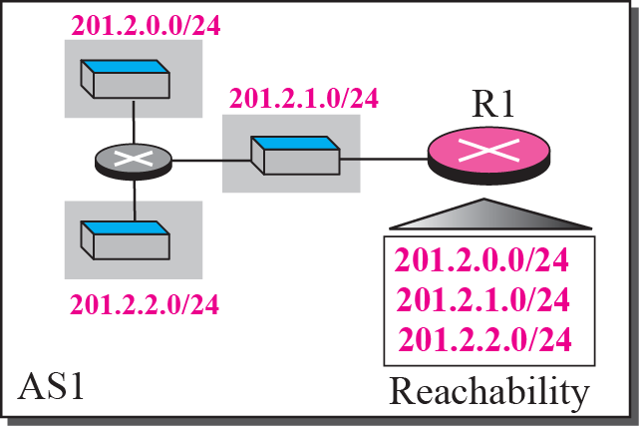
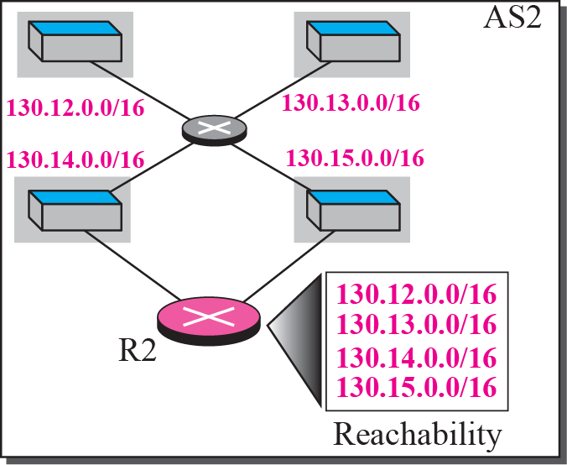


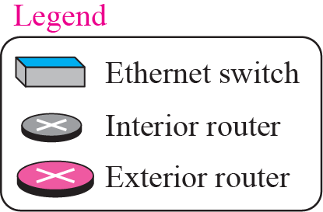
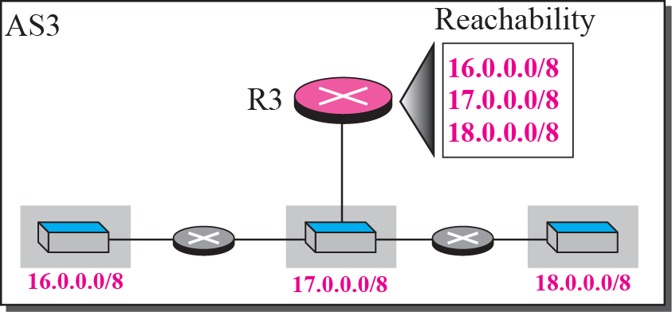
Path Vector Routing Example
Notes:
ข้างในคุย OSPF ข้างนอกคุย BGP

Slide 11
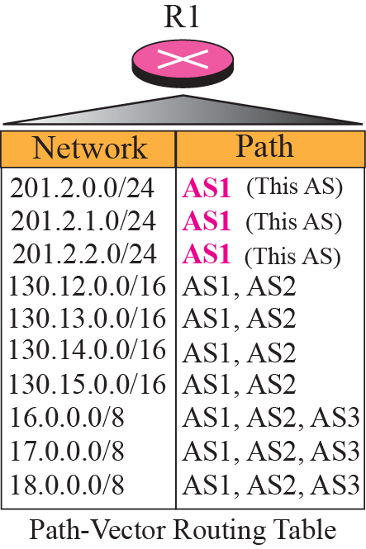
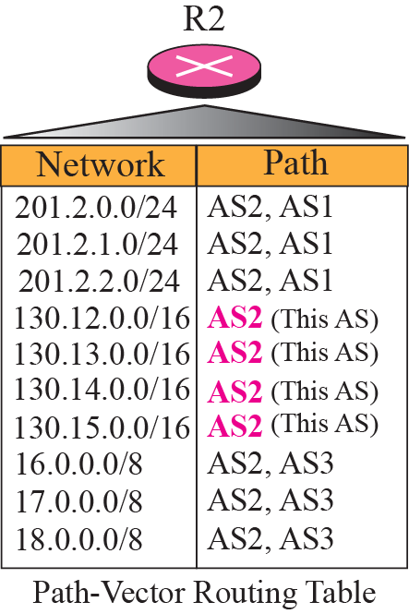
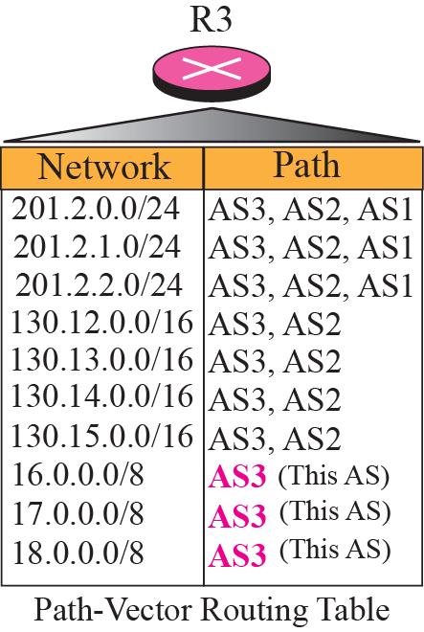
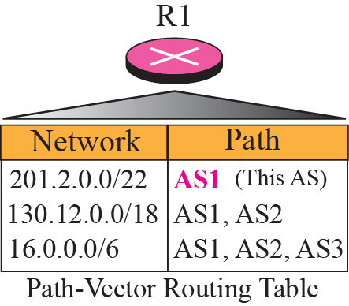
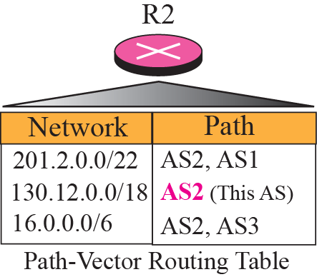
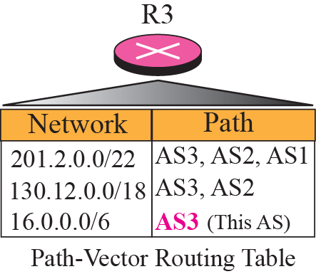
Path Vector Routing Example
Notes:
Path vector routing คือ จากไทยไปจีน หรือ ก็คือ จากนอกๆ เช่นจะไป 18 ก็ไป As1, AS2, AS3 ตามลำดับไรงี้
แล้วมันจะรวบอะไรที่เหมือนกันให้เป็นแบบล่าง เพื่อความสั้นลโดยเปลี่ยน / เอา

Slide 12
Border Gateway Protocol (BGP)
Creating a BGP “peering” relationship involves an interesting combination of trust and mistrust
“Your ISP will show little patience with you if you make mistakes in your BGP configuration”

Slide 13
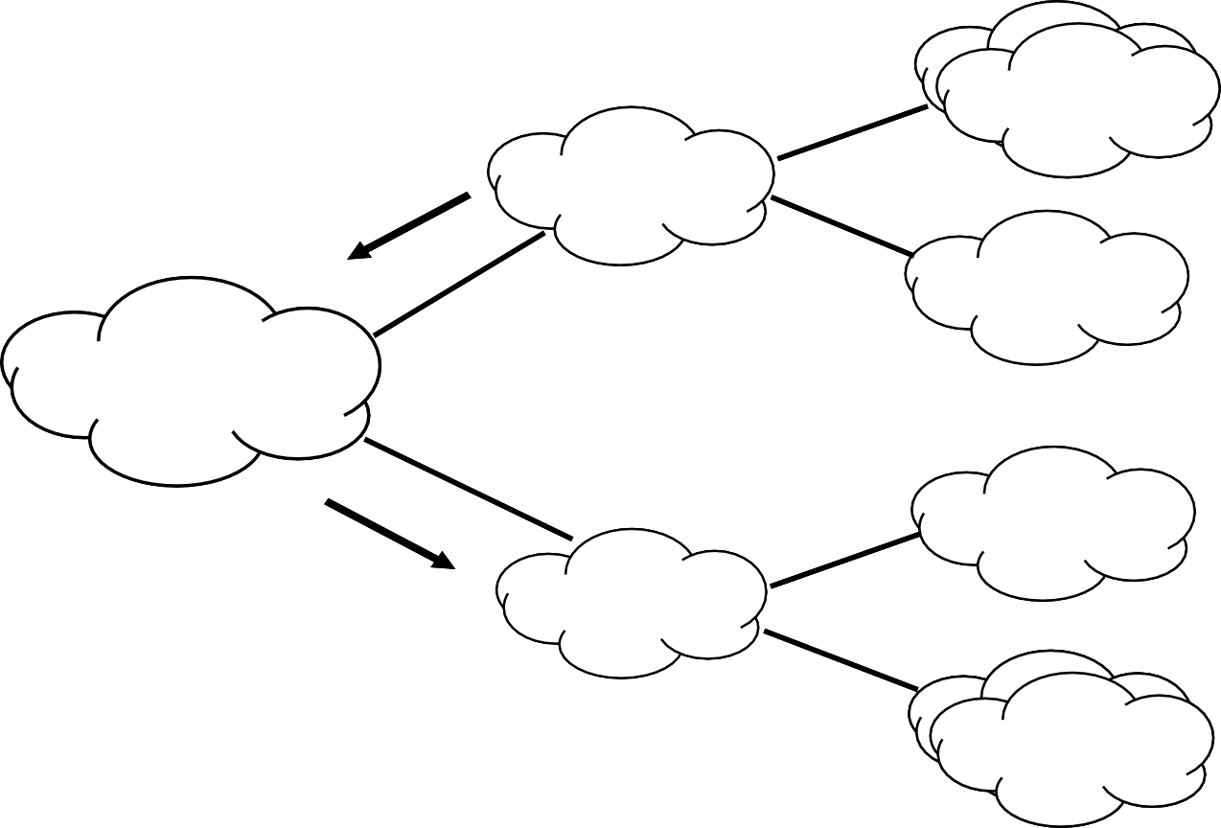
BGP Route Selection
N2 ประกาศเส้นทาง
(<4.0.0.0, 14.0.0.0, 5.0.0.0>,
<AS 2>) ให้้ N1
N4 AS 4
4.0.0.0
14.0.0.0
N2 AS 2
N5 AS 5
5.0.0.0
N1 AS 1
N6 AS 6
N1 ประกาศเส้นทาง
(<4.0.0.0, 14.0.0.0, 5.0.0.0>,
<AS1, AS 2>) ให้้ N3
6.0.0.0
N3 AS 3
N7 AS 7
7.0.0.0
17.0.0.0

Slide 14
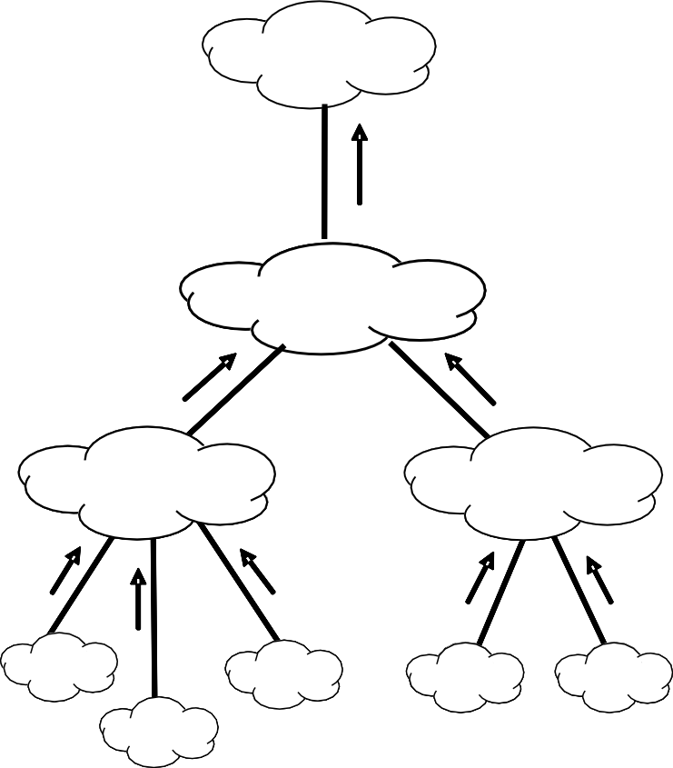
Route Announcement: no CIDR
internet
202.0.1.0/242, 02.0.32.0/24,
202.0.2.0/242, 02.0.33.0/24,
202.0.3.0/24
IISSPP 11
202.0.0.0 - 202.0.255.0
202.0.1.0/24,
202.0.2.0/24,
202.0.3.0/24
202.0.32.0/24,
202.0.33.0/24
ISP 2
ISP 3
202.0.0.0 - 202.0.15.0
202.0.32.0 - 202.0.47.0
202.0.1.0
202.0.3.0
202.0.32.0
202.0.33.0
202.0.2.0
Notes:
ทำการ Aggregate ให้ดีๆ

Slide 15
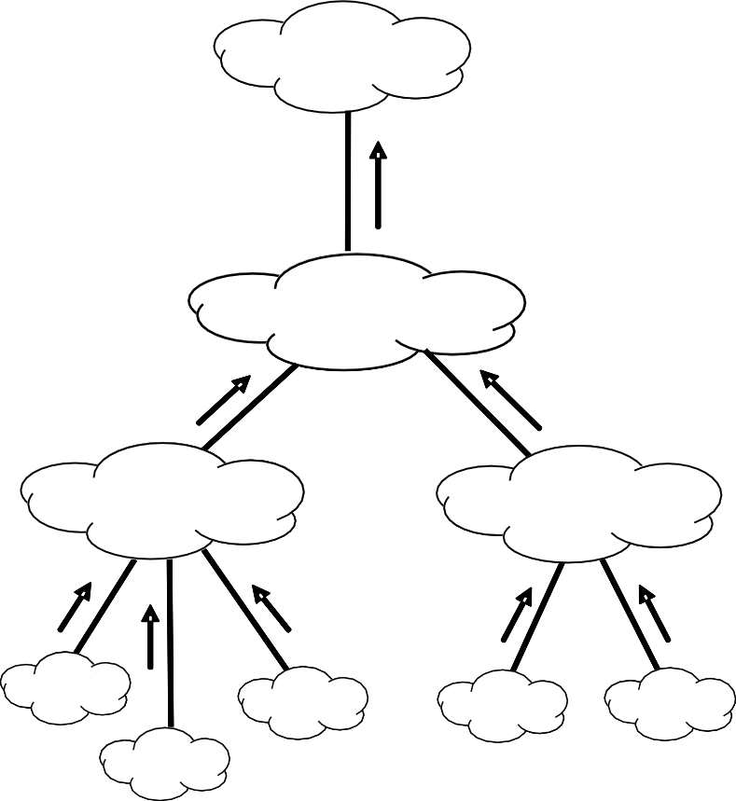
Route Announcement: with CIDR
อนิิิ เทอรเ์์ น็็็ต
202.0.0.0//1166
ISP 1
202.0.0.0/16
202.0.0.0/20
202.0.32..00///222000
ISP 2
ISP 3
202.0.0.0/20
202.0.32.0/20
202.0.1.0
202.0.3.0
202.0.32.0
202.0.33.0
202.0.2.0

Slide 16
BGP Hazards -- Scenario
Suppose, that through some misconfiguration you advertise 207.46.0.0/16 to your ISP.
Your ISP does not filter out and advertise to the
Internet.
This CIDR block belongs to Microsoft, and you have just claimed to have a route to that destination.
Many decide that the best path to Microsoft is through
your domain.
Flood of unwanted packets (black-holed traffic that
should have gone to Microsoft)
They will be neither amused nor understanding.
By Rick Graziani
Notes:
เกิดจากการ Configure ผิด
Configure ว่าไปmicrosoftได้ทุกคนก็ไปทางนี้ซึ่งจริงๆไปไม่ได้ สุดท้ายก็พังกันหมด

Slide 17
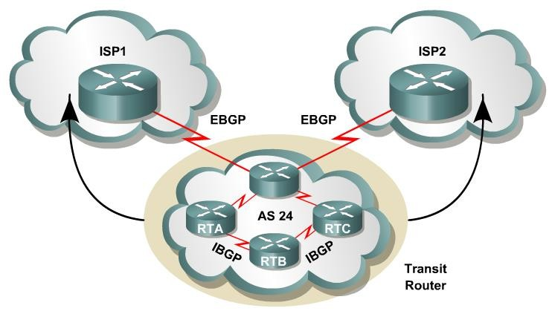
BGP Basics
BGP uses a list of AS numbers through which
a packet must pass to reach a destination.
The function of BGP is to:
Exchange routing information between AS
Guarantee the selection of a loop free path.
Notes:
การอัปเดต BGP จะ Carry บน TCP คือ Reliable มาก และต้องไม่เป็น loop

Slide 18
BGP Basics
BGP4
first version of BGP that supports CIDR and route aggregation.
Common IGPs such as RIP, OSPF, and EIGRP
use technical metrics.
BGP does not use technical metrics.
Routing decisions based on
network policies, or rules
BGP does not show the details of topologies within each AS.
BGP sees only a tree of AS
18
Notes:
BGP4 support Fiber
Base on policies ต้องผ่านเมืองนี้ๆ เท่านั้น และไม่show detail ของแต่ละ asรู้แค่จากกรุงเทพต้องลงปักกิ่ง

Slide 19
BGP Basics
BGP updates are carried using TCP on port 179.
In contrast, RIP updates use UDP port 520
OSPF, IGRP, EIGRP does not use a Layer 4 protocol
Because BGP requires TCP, IP connectivity must
exist between BGP peers.
TCP connections must also be negotiated between them before updates can be exchanged.
Therefore, BGP inherits those reliable, connection-oriented properties from TCP.
Notes:
BGP ต้องใช้ TCP

Slide 20






Loop free Path
AS 10
AS Path: 10
AS Path: 10,20,30,40
AS 20
AS Path: 10,20,30,40
AS Path: 10,20
AS 30
AS 40
AS Path: 10,20,30
BGP views the whole internetwork as a graph, or tree, of AS
Notes:
20 ซ้ำก็โยนทิ้งไปไม่ยอมให้เกิดลูป

Slide 21
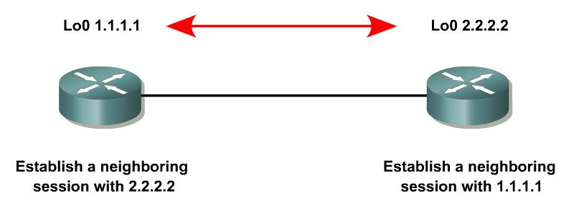
BGP Operation
When two routers establish a TCP- enabled BGP connection between each other, they are called neighbors or peers.
Each router running BGP is called a BGP speaker.
21
Notes:
มันจะสร้าง neighbor section เข้าหากันหรือการทำpeer เรียก BGP Speaker

Slide 22
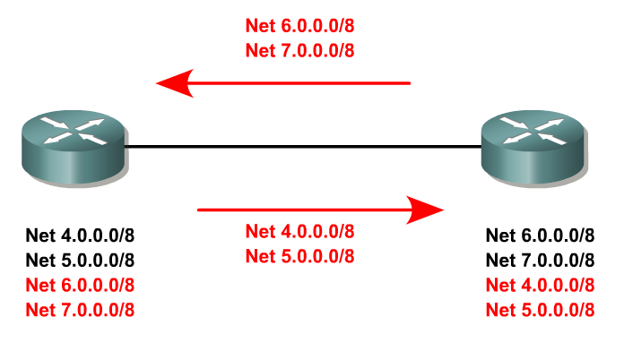
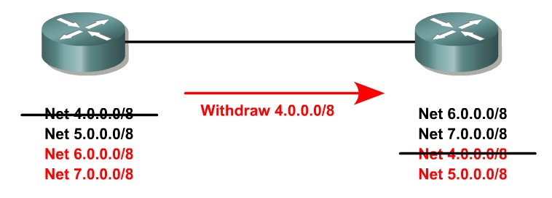
Exchange and Update
Exchange Incremental updates
Withdraw route
Peers exchange keepalive messages (e.g. 60 sec for Cisco)
to ensure the connection is maintained.
Notes:
หลังจากทำ TCP เรียบร้อย Reliable นะก็จะเริ่ม Exchange กันแบบ Incremental update withdraw ก็เช่นกัน

Slide 23
BGP Message
There are four BGP message types:
Type 1: OPEN (After the TCP establishment, both neighbors send Open messages)
Type 2: KEEPALIVE
Type 3: UPDATE
Type 4: NOTIFICATION
All BGP messages are Unicast to the one
neighbor over the TCP connection.

Slide 24
IPv6 Routing
24

Slide 25
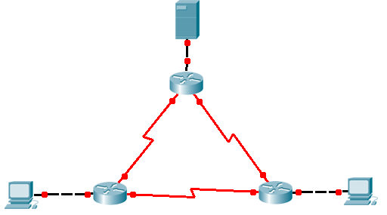
IPv6 routing
2001:3c8:1303:1111::/64
.2
.1
BKK
.2
.1
2001:3c8:1303:AAAA::/64
2001:3c8:1303:BBBB::/64
KPG
.1
SRI
.2
.2
.1
.2
.1
.1
.2
2001:3c8:1303:CCCC::/64
2001:3c8:1303:2222::/64
2001:3c8:1303:3333::/64

Slide 26
2001:3c8:1303:1111::/64
.2
.1
BKK
.2
.1
2001:3c8:1303:AAAA::/64
2001:3c8:1303:BBBB::/64
2001:3c8:1303:2222::/64
.1
.2
2001:3c8:1303:3333::/64
.2 .1
.2
.1
.1
.2
KPG#show ipv6 route
KPG
2001:3c8:1303:CCCC::/64
SRI
IPv6 Routing Table - 10 entries
Codes: C - Connected, L - Local, S - Static, R - RIP, B - BGP U - Per-user Static route, M - MIPv6
I1 - ISIS L1, I2 - ISIS L2, IA - ISIS interarea, IS - ISIS summary
O - OSPF intra, OI - OSPF inter, OE1 - OSPF ext 1, OE2 - OSPF ext 2 ON1 - OSPF NSSA ext 1, ON2 - OSPF NSSA ext 2
D - EIGRP, EX - EIGRP external
C 2001:3C8:1303:AAAA::/64 [0/0]
via ::, Serial0/0/0
L 2001:3C8:1303:AAAA::1/128 [0/0]
via ::, Serial0/0/0
R 2001:3C8:1303:BBBB::/64 [120/2]
via FE80::1, Serial0/0/0 via FE80::3, Serial0/0/1
C 2001:3C8:1303:CCCC::/64 [0/0]
via ::, Serial0/0/1
L 2001:3C8:1303:CCCC::2/128 [0/0]
via ::, Serial0/0/1 L FF00::/8 [0/0]
via ::, Null0
R 2001:3C8:1303:1111::/64 [120/2]
via FE80::1, Serial0/0/0
C 2001:3C8:1303:2222::/64 [0/0]
via ::, FastEthernet0/0
L 2001:3C8:1303:2222::1/128 [0/0]
via ::, FastEthernet0/0
R 2001:3C8:1303:3333::/64 [120/2]
via FE80::3, Serial0/0/1

Slide 27
L – Local ?
Was made to create a corresponding CEF (Cisco Express Forwarding) entry (L3 IP Switching Technology)
Then, the packets destined to this IP address assigned to the router interface can be processed by the router itself
These routes came with the introduction of the IOS feature, Multi Topology Routing (MTR)
Local routes serve a significant function with MTR
http://www.ascoltablog.com/what-is-the-l-designation-in-a-cisco-routing-table/
27

Slide 28
L – Local ?
interface Ethernet0/0
ip address 10.1.1.1 255.255.255.252
The IP address assigned to Ethernet0/0 is 10.1.1.1/30. This assignment itself is not a host route, but with the proper version of IOS, a Local host route will be installed in the routing table.
R1#show ip route
Codes: L – local, C – connected, S – static, R – RIP, M – mobile, B – BGP
Gateway of last resort is not set
C | 10.0.0.0/8 is 10.1.1.0/30 | variably subnetted, 7 subnets, 2 masks is directly connected, Ethernet0/0
L | 10.1.1.1/32 | is directly connected, Ethernet0/0
 |  | 28
Notes:
L คือ Local connect อยู่เพื่อเพิ่มค่าการรันของ CEF

Slide 29
2001:3c8:1303:1111::/64
.2
.1
BKK
.2
.1
2001:3c8:1303:AAAA::/64
2001:3c8:1303:BBBB::/64
2001:3c8:1303:2222::/64
.1
.2
2001:3c8:1303:3333::/64
.2 .1
.2
.1
.1
.2
BKK#show ipv6 route
KPG
2001:3c8:1303:CCCC::/64
SRI
IPv6 Routing Table - 10 entries
Codes: C - Connected, L - Local, S - Static, R - RIP, B - BGP U - Per-user Static route, M - MIPv6
I1 - ISIS L1, I2 - ISIS L2, IA - ISIS interarea, IS - ISIS summary
O - OSPF intra, OI - OSPF inter, OE1 - OSPF ext 1, OE2 - OSPF ext 2 ON1 - OSPF NSSA ext 1, ON2 - OSPF NSSA ext 2
D - EIGRP, EX - EIGRP external
C 2001:3C8:1303:AAAA::/64 [0/0]
via ::, Serial0/0/0
L 2001:3C8:1303:AAAA::2/128 [0/0]
via ::, Serial0/0/0
 |  | C | 2001:3C8:1303:BBBB::/64 [0/0]
C | 2001:3C8:1303:1111::/64 [0/0] |  | via ::, Serial0/0/1
 | via ::, FastEthernet0/0 | L | 2001:3C8:1303:BBBB::1/128 [0/0]
L | 2001:3C8:1303:1111::1/128 [0/0] |  | via ::, Serial0/0/1
 | via ::, FastEthernet0/0 | R | 2001:3C8:1303:CCCC::/64 [120/2]
R | 2001:3C8:1303:2222::/64 [120/2] |  | via FE80::2, Serial0/0/0
 | via FE80::2, Serial0/0/0 |  | via FE80::3, Serial0/0/1
R | 2001:3C8:1303:3333::/64 [120/2] | L | FF00::/8 [0/0]
via FE80::3, Serial0/0/1
via ::, Null0
Notes:
มีC เท่าไหร่มี L เท่านั้น

Slide 30
2001:3c8:1303:1111::/64
.2
.1
BKK
.2
.1
2001:3c8:1303:AAAA::/64
2001:3c8:1303:BBBB::/64
2001:3c8:1303:2222::/64
.1
.2
2001:3c8:1303:3333::/64
.2 .1
.2
.1
.1
.2
SRI#show ipv6 route
KPG
2001:3c8:1303:CCCC::/64
SRI
IPv6 Routing Table - 10 entries
Codes: C - Connected, L - Local, S - Static, R - RIP, B - BGP U - Per-user Static route, M - MIPv6
I1 - ISIS L1, I2 - ISIS L2, IA - ISIS interarea, IS - ISIS summary
O - OSPF intra, OI - OSPF inter, OE1 - OSPF ext 1, OE2 - OSPF ext 2 ON1 - OSPF NSSA ext 1, ON2 - OSPF NSSA ext 2
D - EIGRP, EX - EIGRP external
R 2001:3C8:1303:AAAA::/64 [120/2]
via FE80::1, Serial0/0/0 via FE80::2, Serial0/0/1
C 2001:3C8:1303:BBBB::/64 [0/0]
via ::, Serial0/0/0
R | 2001:3C8:1303:1111::/64 [120/2] | L | 2001:3C8:1303:BBBB::2/128 [0/0]
 | via FE80::1, Serial0/0/0 |  | via ::, Serial0/0/0
R | 2001:3C8:1303:2222::/64 [120/2] | C | 2001:3C8:1303:CCCC::/64 [0/0]
 | via FE80::2, Serial0/0/1 |  | via ::, Serial0/0/1
C | 2001:3C8:1303:3333::/64 [0/0] | L | 2001:3C8:1303:CCCC::1/128 [0/0]
 | via ::, FastEthernet0/0 |  | via ::, Serial0/0/1
L | 2001:3C8:1303:3333::1/128 [0/0] | L | FF00::/8 [0/0]
via ::, FastEthernet0/0
via ::, Null0

Slide 31
RIPng
Routing Information Protocol next generation
Similar to RIP for IPv4
Based on RIPv2
Distance vector protocol
hop-count limit is 15
Split horizon and poison reverse are used to prevent routing loops
http://computernetworkingnotes.com/ipv6-features-concepts-and-configurations/routing-with-ipv6.html

Slide 32
RIPng
Routing Information Protocol next generation
Enhancements
An IPv6 packet is used to transport the routing
update
ALL-RIP routers multicast address (FF02::9) is used as the destination address in routing advertisements (UDP port 521)
Routing updates contain the IPv6 prefix of
the router and the next-hop IPv6 address
Enabling RIPng
Router(config)# ipv6 router rip tag
http://computernetworkingnotes.com/ipv6-features-concepts-and-configurations/routing-with-ipv6.html
Notes:
ตอนนี้ V6 มีprefixแบบนี้ต้องทำไงๆๆ

Slide 33
OSPFv3
Link-state routing protocol
Adjacencies and next-hop attributes now use link-local addresses
Still uses multicast traffic to send its
updates and acknowledgments
FF02::5 for OSPF routers
FF02::6 for OSPF-designated routers
These new addresses are the replacements for
224.0.0.5 and 224.0.0.6, respectively
http://computernetworkingnotes.com/ipv6-features-concepts-and-configurations/routing-with-ipv6.html

Slide 34
KU and
Thailand Interconnection Network

Slide 35

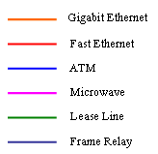





Internet
24 April 2005
Thaisarn
Uninet
Area 0
1GKU Gateway
KPS
Area 10
Firewall & Shaper & Cache
Area 11
SRI
RAT
6M
1G
34M
Area 12
2M
2M
CSC
Area 2
NOP
100M
OCS
34M
1G
512K
Area 5
OCS
SATIT
2M
50Year
Area 4
Area 1
Area 13
SPN
Area 3
SCI
LIB
1G
ENG
Notes:
เกษตรออกไปได้สองทางไทยสาน ยูนิเน็ต รูปถัดไป

Slide 36
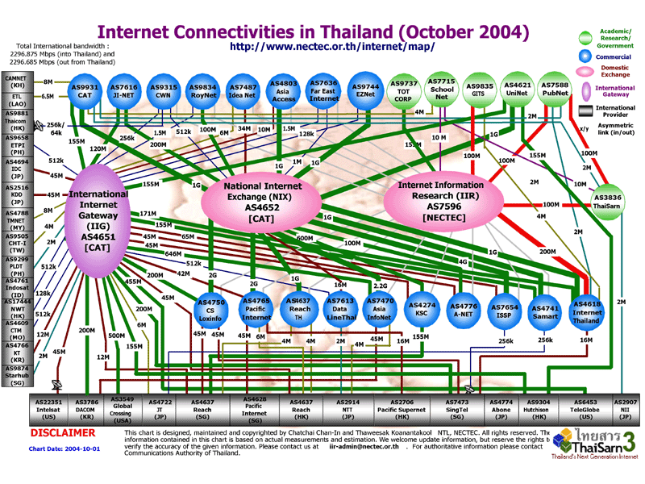
36

Slide 37
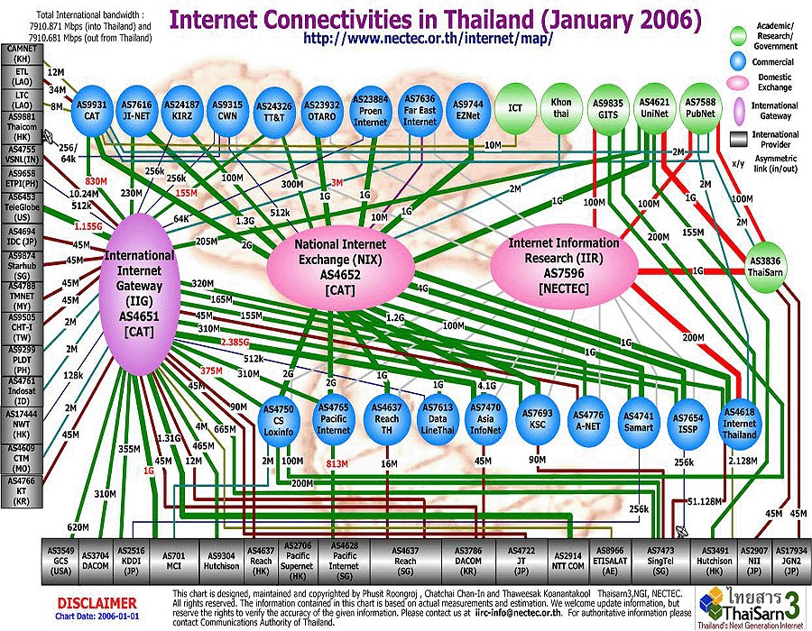
37

Slide 38
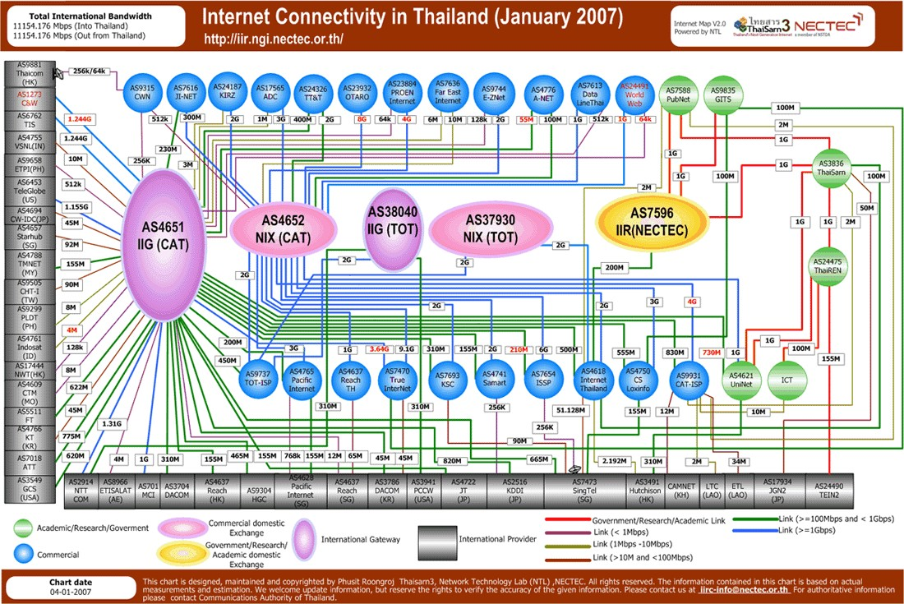

Slide 39
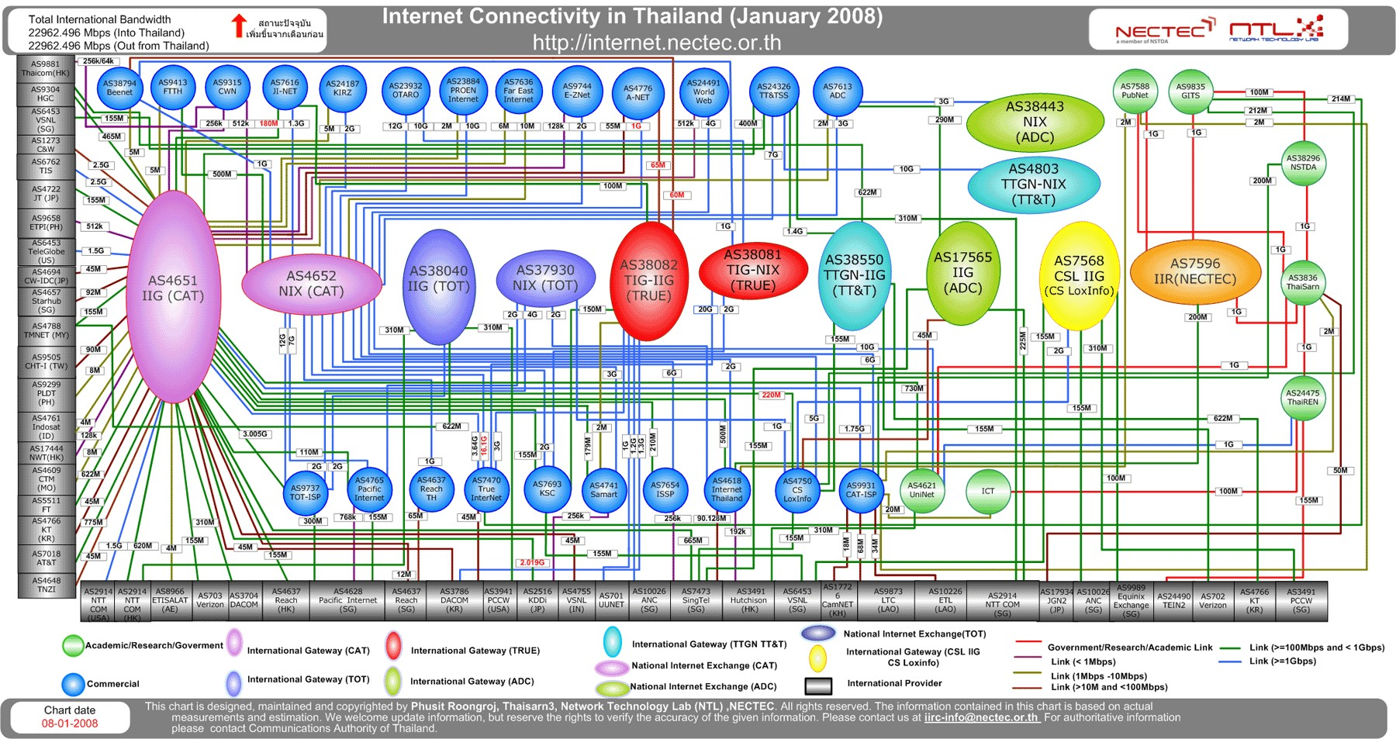

Slide 40
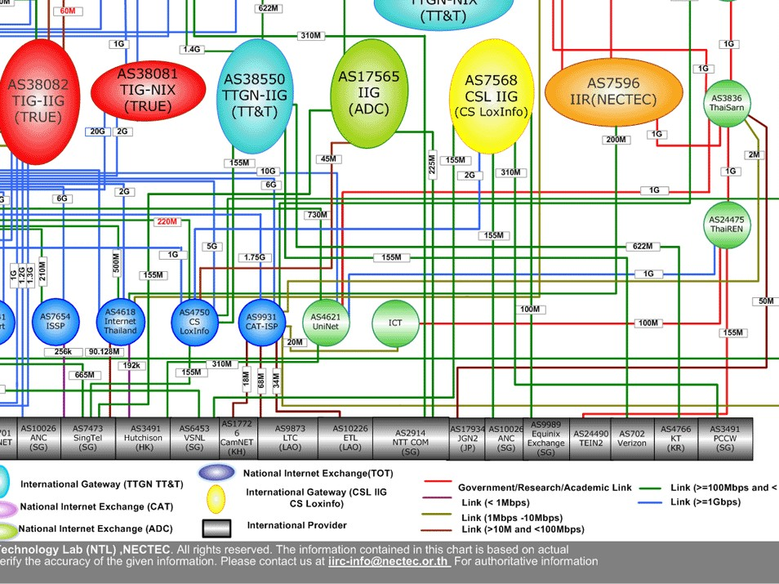
40

Slide 41
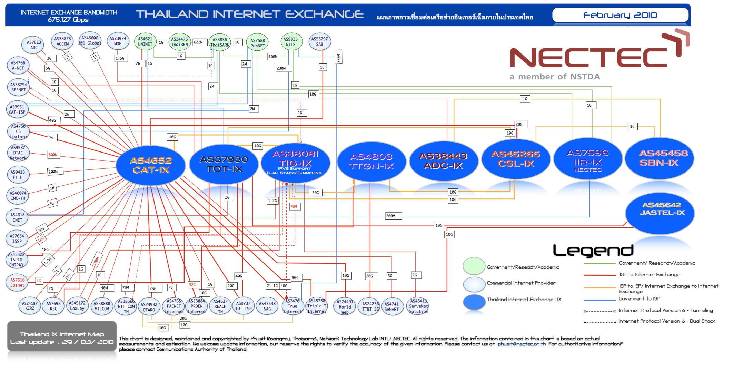
National – Feb 2010

Slide 42
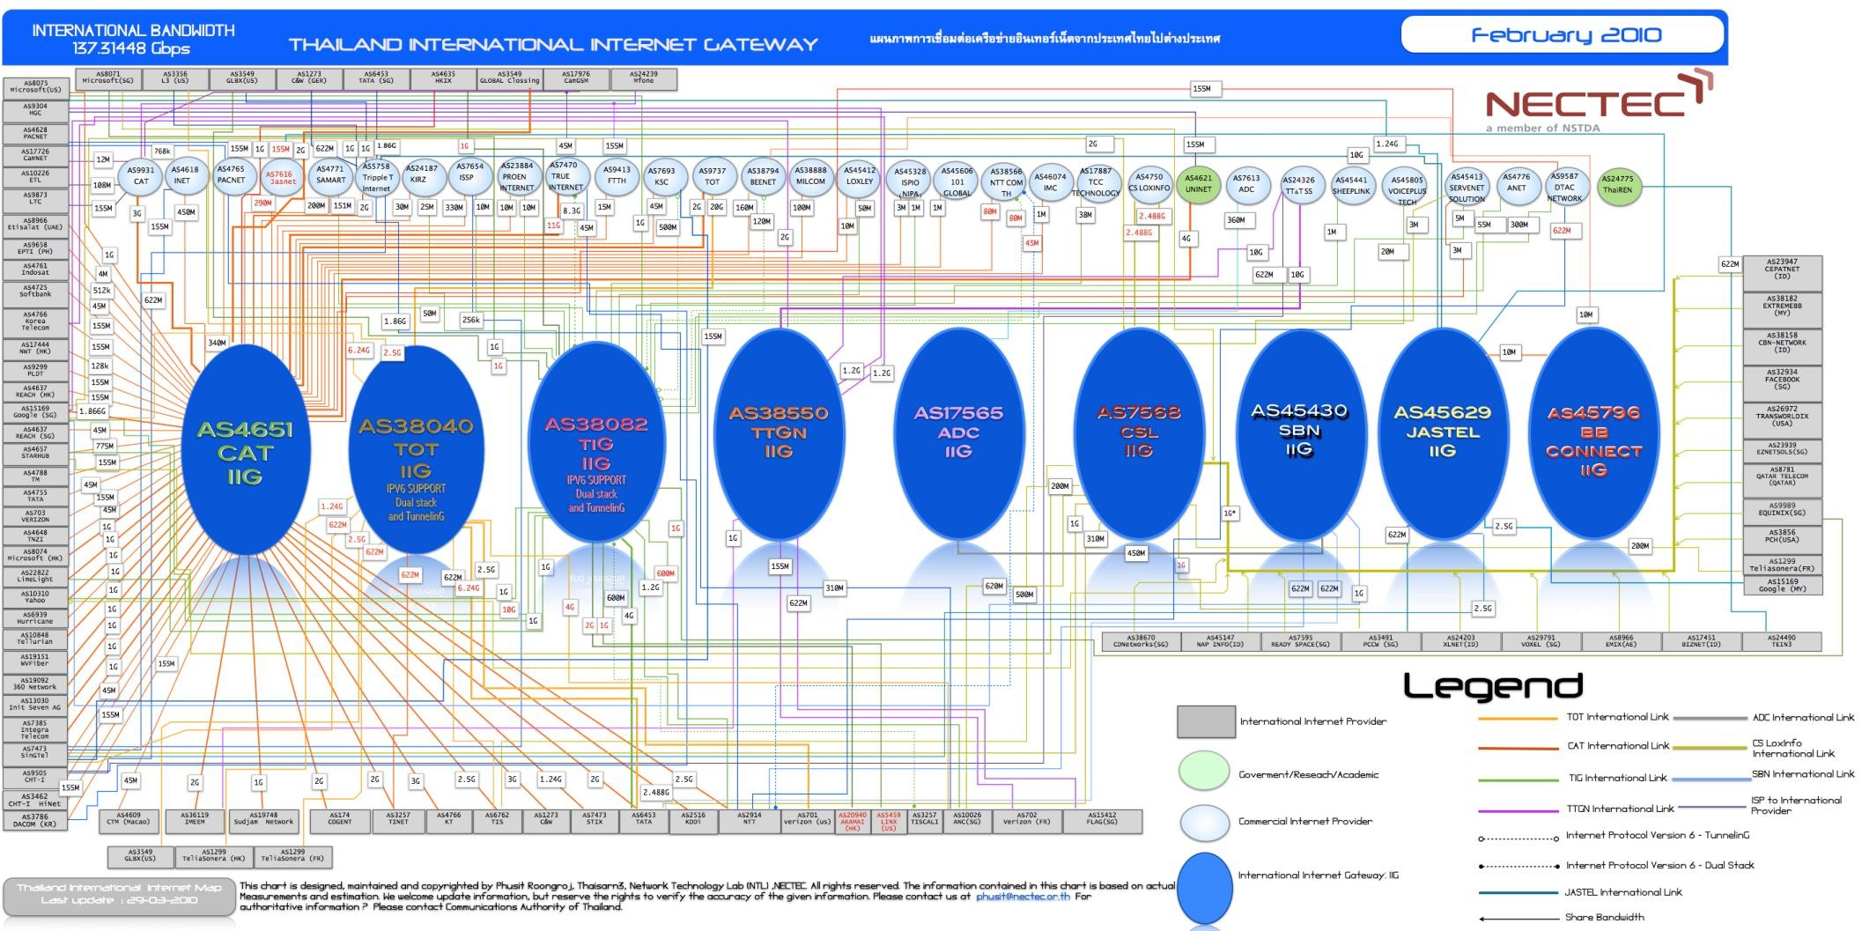
International - Feb 2010

Slide 43
References
CCNP slide by Rick Graziani, Cabrillo College, Feb. 2004
Internet Information Research Center
(IIRC)
http://iir.ngi.nectec.or.th

